Slide 1

Logistics Optimization for Delivery Routes

Slide 2
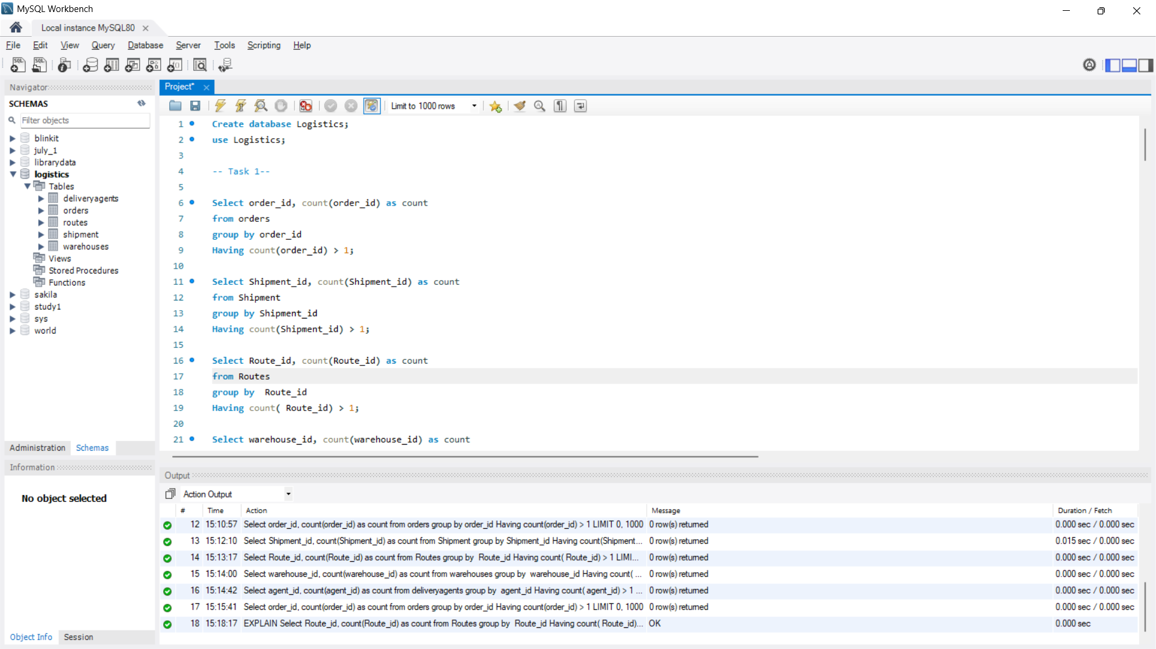
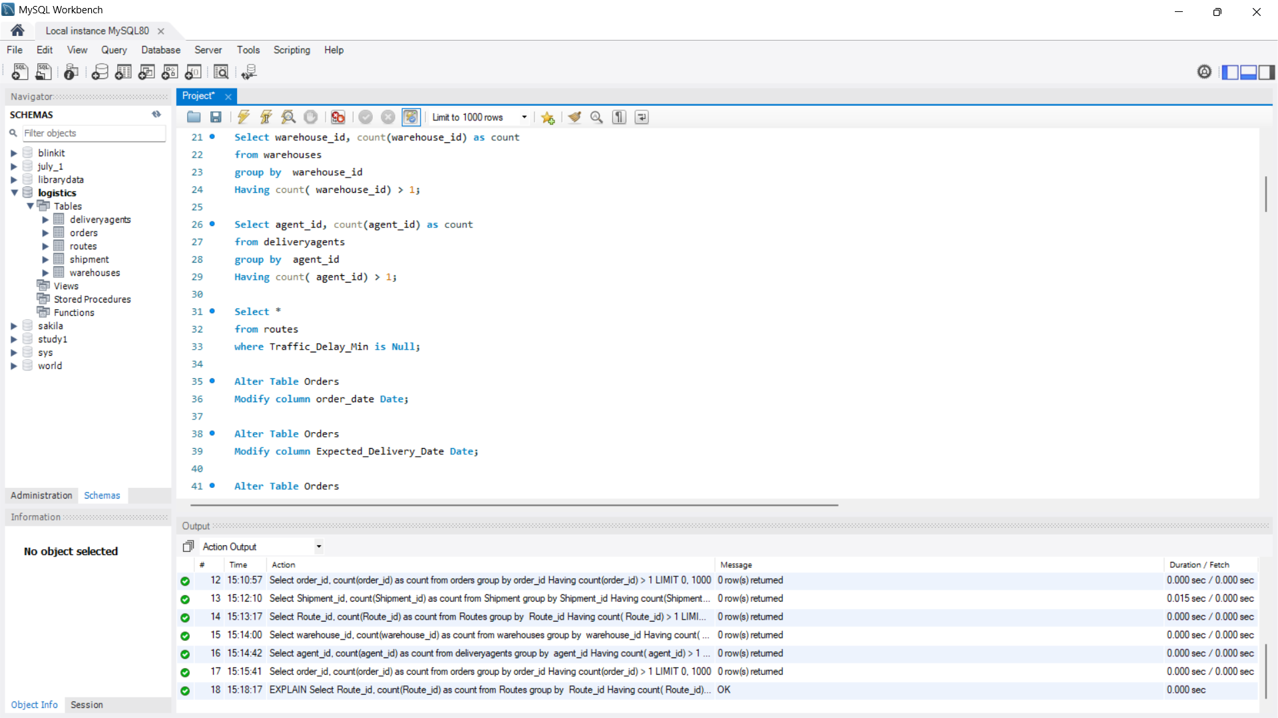
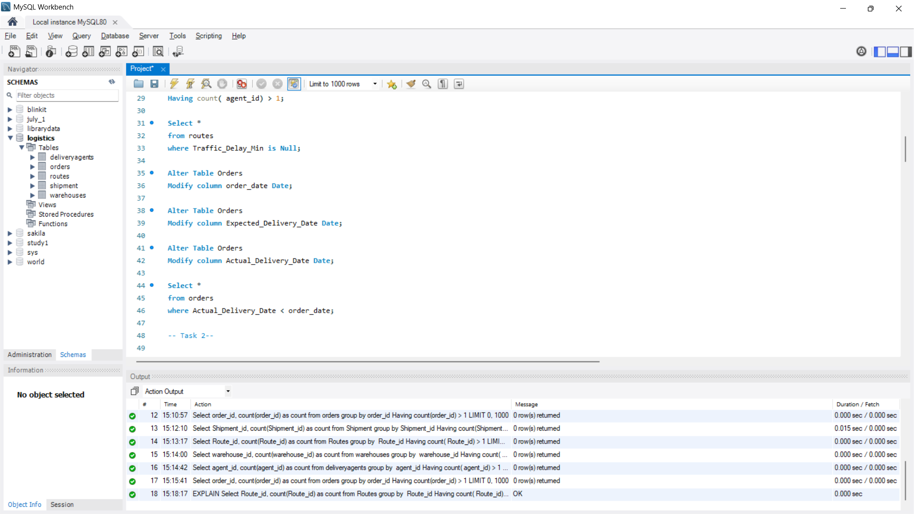
Task 1
Result 1: No Duplicate Values or Null Values found
Result 2: The data types of date columns were modified

Slide 3
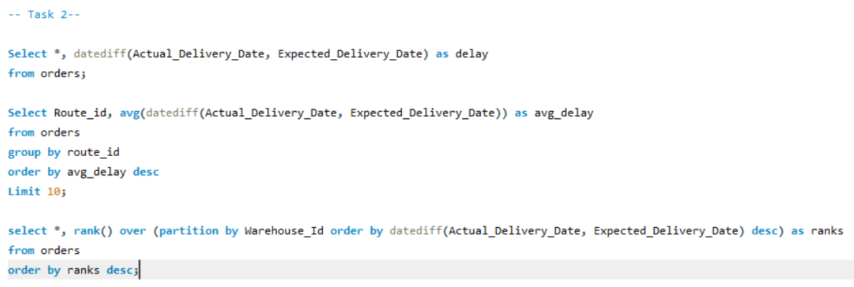
Task 2
Result1 : The delay was calculated for the deliveries
Result2 : The for top 10 routes based on avg delay are displayed in the char
Result3 : Used Windows to rank all orders by delay within each warehouse.

Slide 4
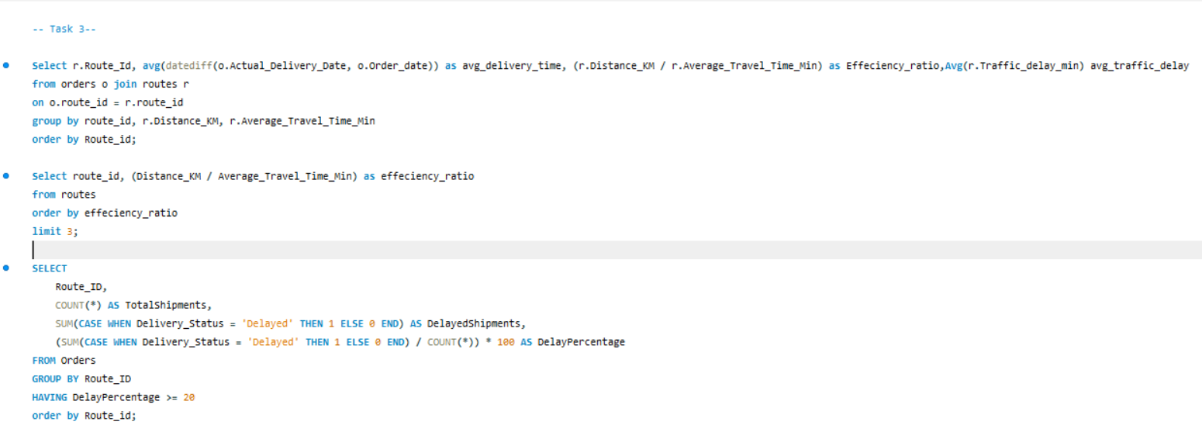
Task 3

Slide 5
Result for Task 3
Top 3 Routes with worst efficiency
Top 3 Routes with Highest delay Percentage
route_id | effeciency_ratio
R016 | 0.151205
R006 | 0.160656
R008 | 0.243721
Route_ID | TotalShipments | DelayedShipments | DelayPercentage
R020 | 17 | 12 | 70.5882
R012 | 12 | 8 | 66.6667
R017 | 14 | 8 | 57.1429

Slide 6
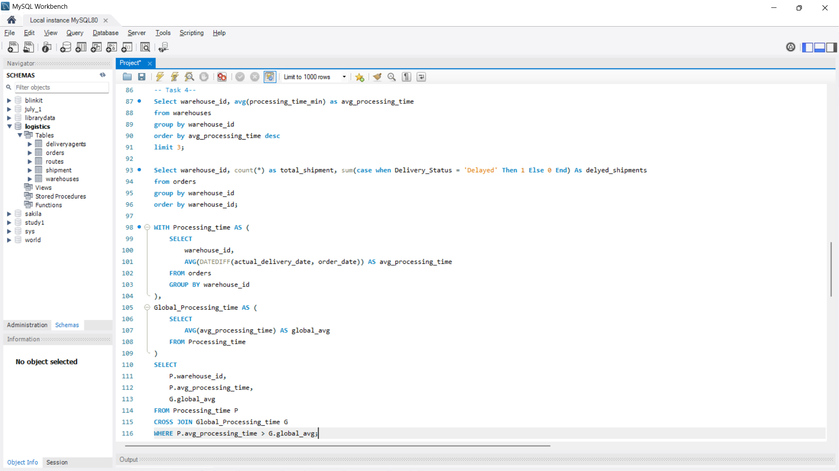
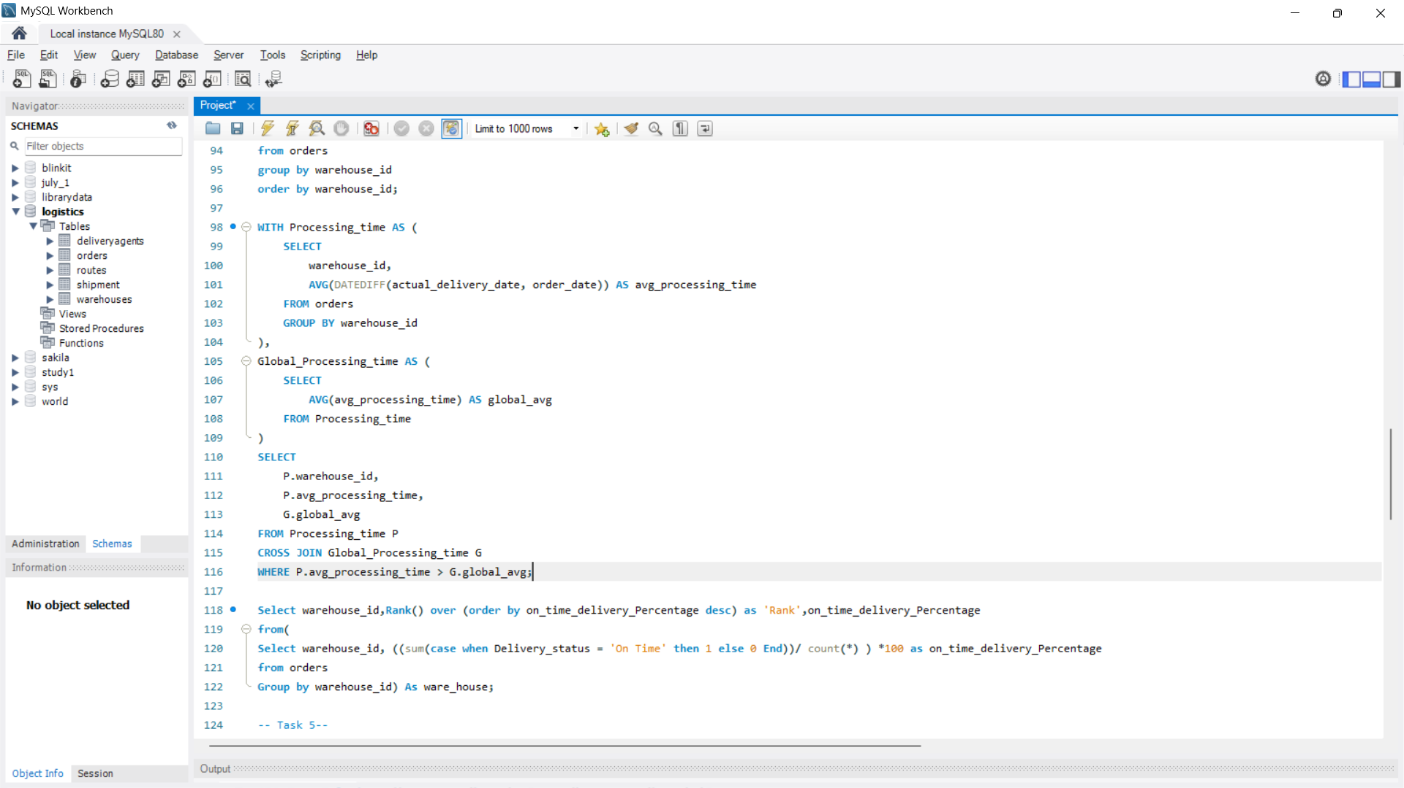
Task 4

Slide 7
Result for Task 4

Slide 8
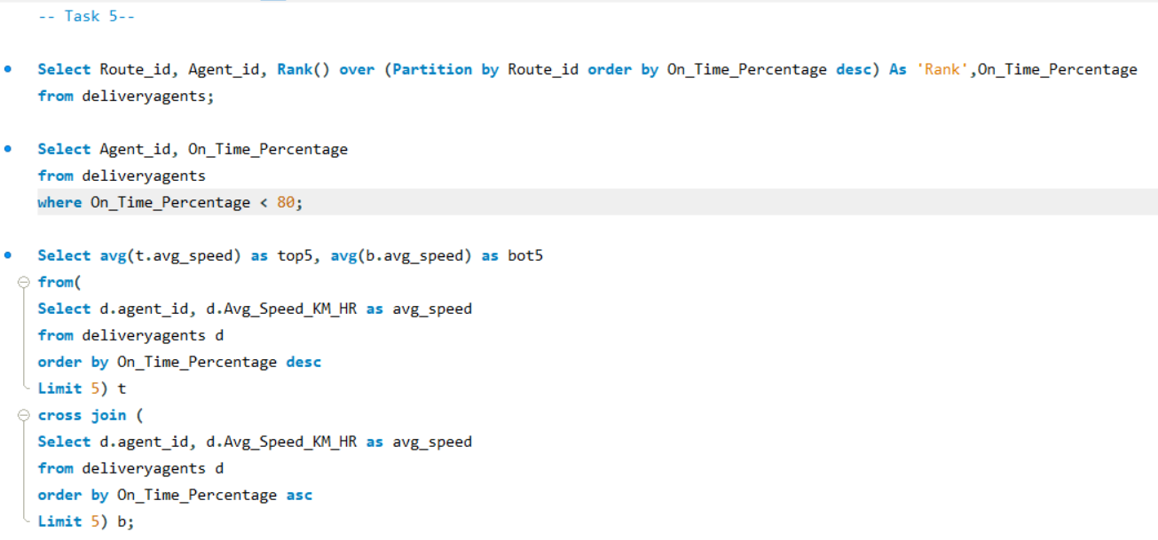
Task 5

Slide 9
Result for Task 5

Slide 10
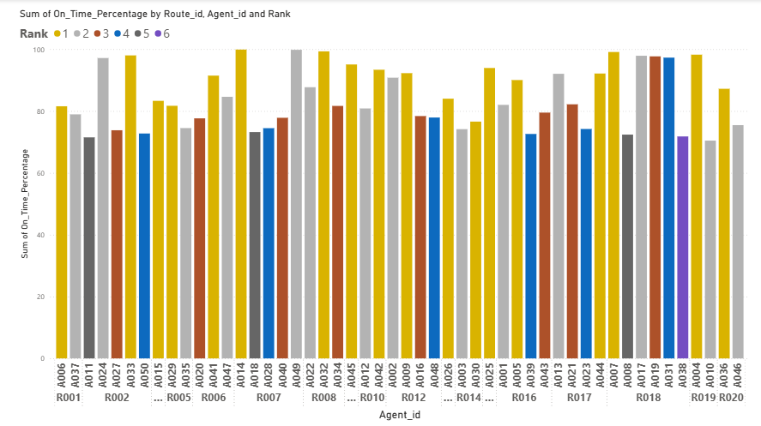

Slide 11
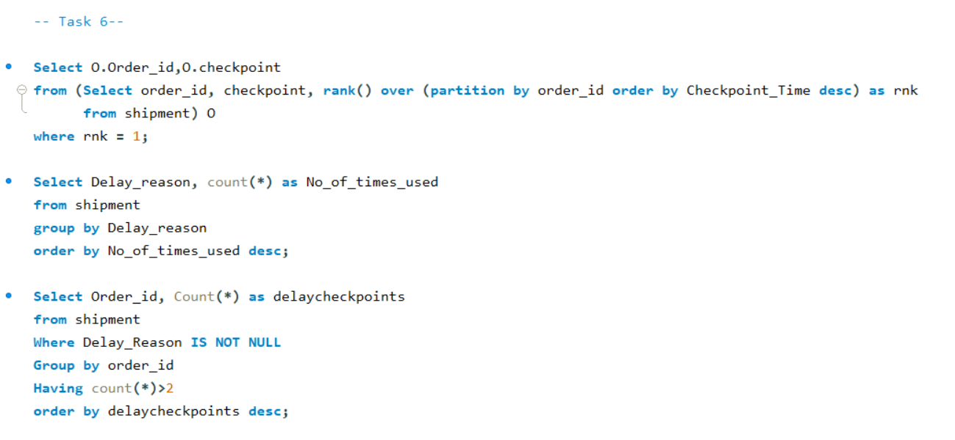
Task 6

Slide 12
Result for Task 6

Slide 13
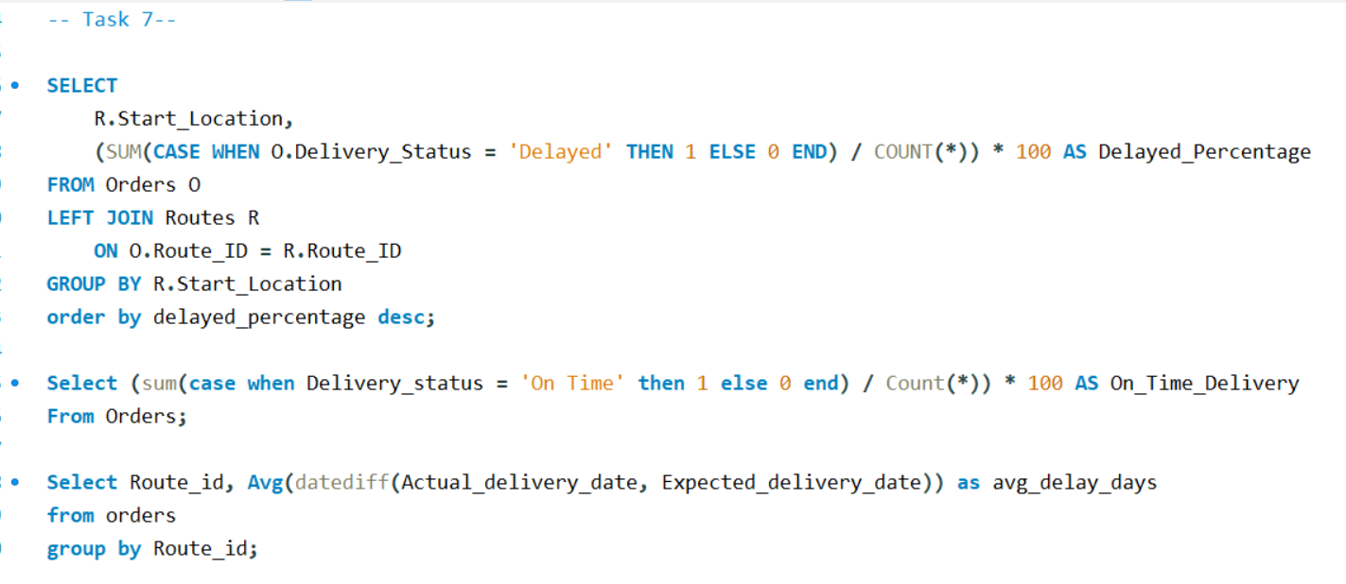
Task 7

Slide 14
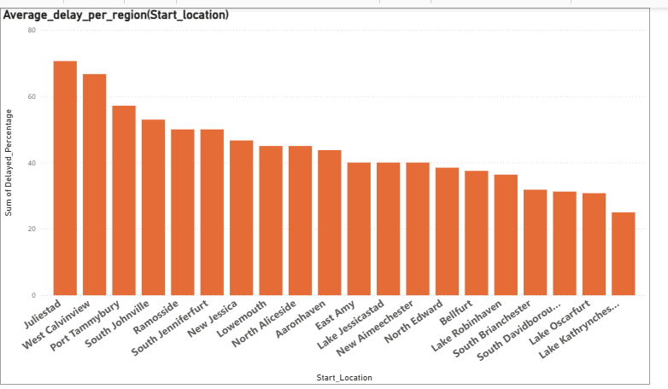
Result for Task 7.1

Slide 15
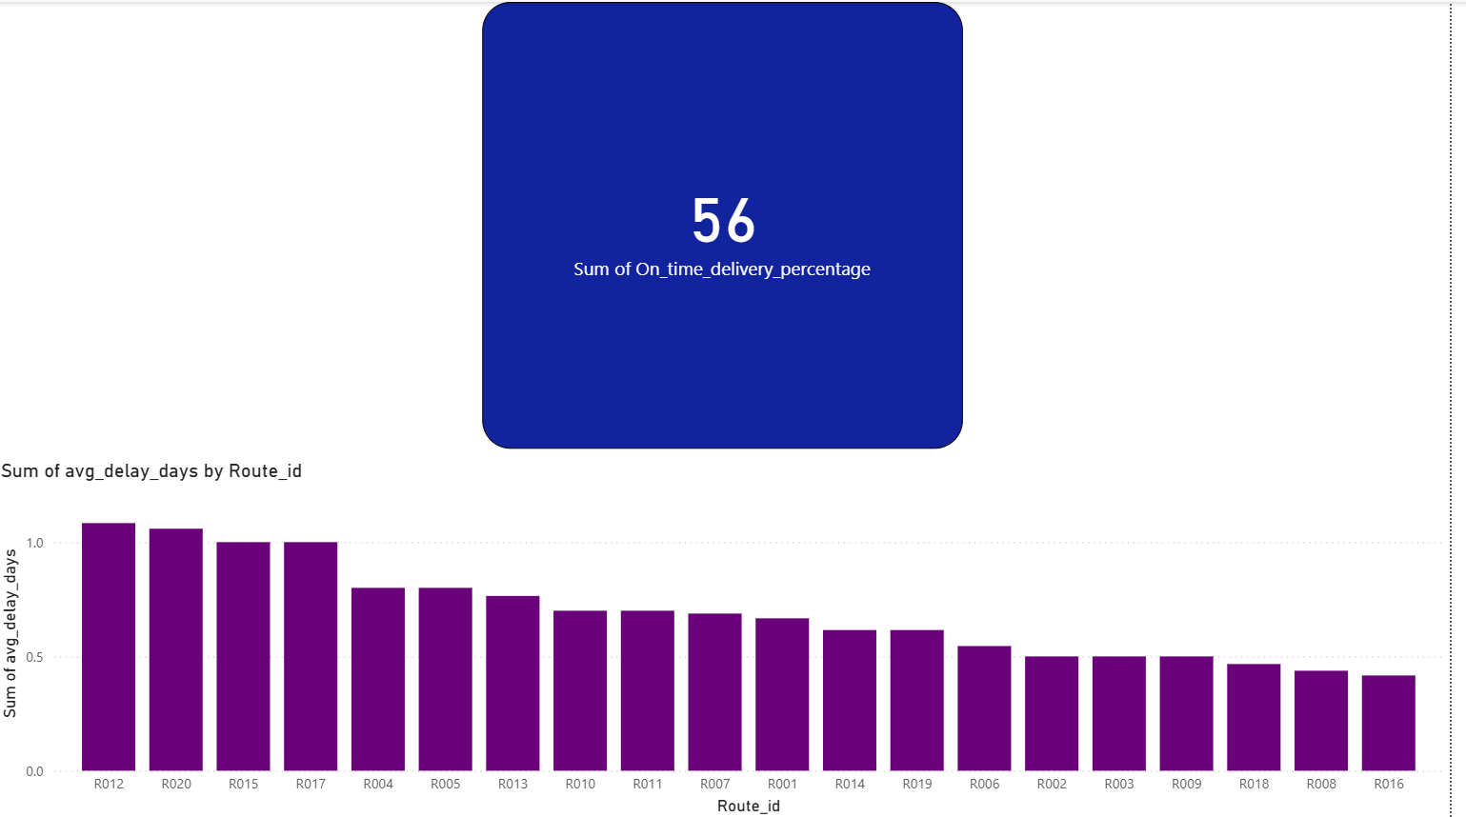
Result for Task 7.2 & 7.3

Slide 16
Thank You

